Slide 1
SyncServerII: Server and Framework
User owned mobile app cloud data
with safe sharing

Slide 2
Notes:
Mississippi river; 4/24/11; taken to the South.

Slide 3
Topics
General concept
Use cases
System architecture
SharedImages: Example app
Next steps

Slide 4
General Concept
General purpose client framework & server
Can be applied to numerous apps
Each needs a separate server and (iOS) app
Notes:
The fact of it being an iOS app is ”just” because I only have support for iOS right now. In principle could have Android and others.

Slide 5
Notes:
On the left, in orange, separate user mobile devices
On the right, owning users cloud storage– with the horizontal partition indicating that some of the data is available for SyncServer usage, and some is not.
The symbol on the database is to indicate meta data– we’re not storing user data in the server database– rather we’re storing meta data such as user oauth creds, and names of files.

Slide 6
Use Case 1) Private social media
Current social media
Data stored on corporate servers; you can lose ownership both “physically” of files and in terms of intellectual property.
If developer makes use of SyncServer, then:
Data content (e.g., images) is stored in app users cloud (e.g., Google Drive)
Data can also be safely shared with friends through various sign-in methods (e.g., Facebook)
User retains ownership
“private” data: is not searchable
Notes:
By private, I do not meen encrypted; I mean in terms of ownership.

Slide 7
Use Case 2) Data longevity
Apps sometimes hide their data
For example, you enter your favorite restaurant meals and preferences, and images of those events
App stores data internally
If app stops being supported, you lose access to data
If you lose your device or your backup fails, you lose access to data
If developer make use of SyncServer, then:
Data stored in normal files (not special database or otherwise obscured formats)
Data is stored in normal places in your cloud storage.
E.g., in Dropbox, /Apps/<AppName>/<YourFiles>
Also enables backup and recovery in same manner

Slide 8
Use Case 3) Developers save $$$
Why should developers or small companies pay for storing users data?
SyncServer stores content data in users own cloud storage
Meta-data, & some user credentials stored on server
Estimate: Server data is about 1/100th size of content data
Notes:
General metadata: e.g., File names, content (mime) types, update dateApplication-specific meta-data
Sometimes applications will choose to store additional data on a server; this is design/app specific
Limited user credentials: Modern sign-in systems use Oauth for sign-in (e.g., Facebook, Dropbox, Google); revokable or expiring access tokens are stored in the server database

Slide 9
Use case 4) Offline use of data
All too often apps become inoperable without network access
iOS client for SyncServer
Encourages offline operation
New data queued for upload, with no network access
Queued data survives app re-launches
And app crashes
Network againavailable: Uploads and downloads can again occur.
If app makes data available offline, then SyncServer can provide the other side
Notes:
This is a somewhat different issue– a separate set of features. I.e., offline use of data is really a different set of features from storing user data in their cloud and safely sharing that data.

Slide 10
System Architecture
Mobile iOS app
Facebook
(authentication)
App
Client
framework
Server
Google Drive
Dropbox
database
Notes:
Key point: This server and client framework are general purpose. They can be applied to numerous apps. Each needs a separate server deployed and a separate (iOS) app.
Slightly simplified: Doesn’t show communication from client to Google, Dropbox, and Facebook for signin
Icon/meta data from: http://test.peregrinecloud.com/solutions/remove-metadata-with-cleandocs/

Slide 11
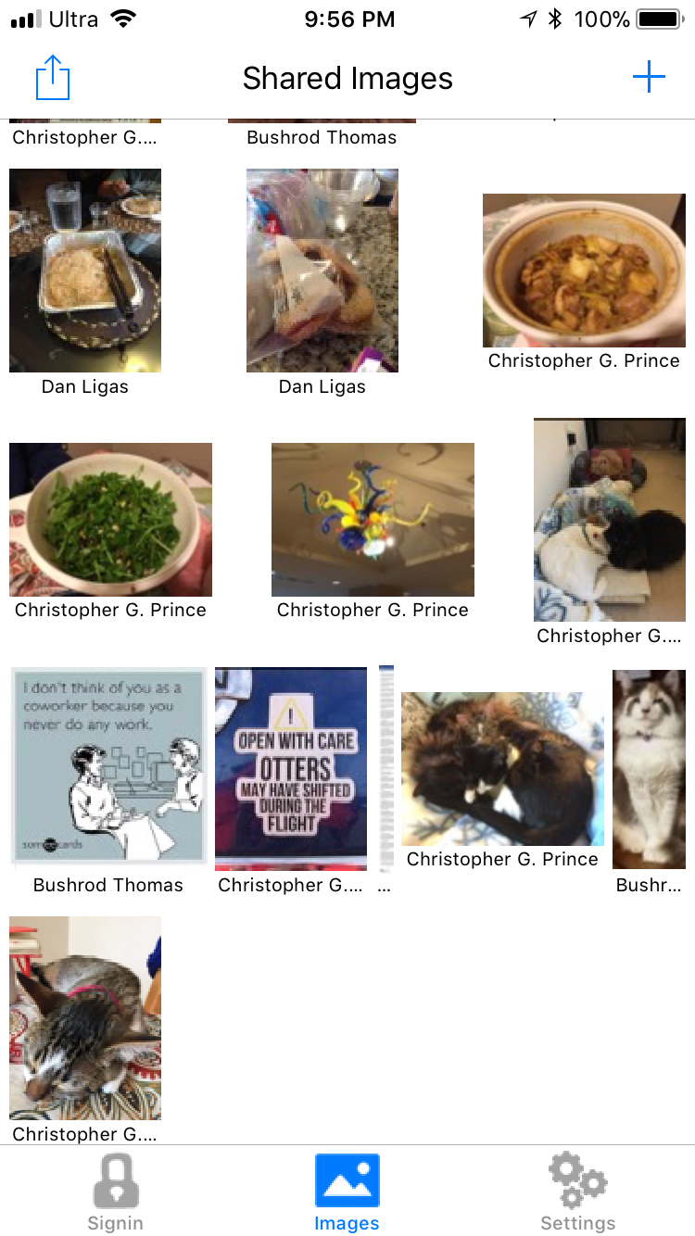
Example App: SharedImages
Enables images to be shared amongst users
Step through typical use of app:
1) Upload an image
2) Share with a new person
3) Sharing user downloads
Notes:
iOS app currently with TestFlight versions (not Apple App store)
Server runs on AWS Elastic Beanstalk
Database: AWS RDS/mySQL

Slide 12
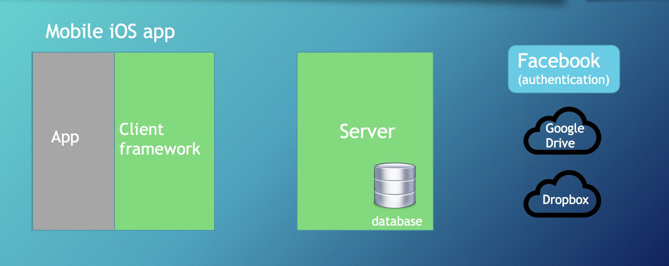
1) Upload an image
Notes:
Client records image UUID, version, and sends this and contents to server.
Server records meta data in database, and uploads to cloud storage.

Slide 13
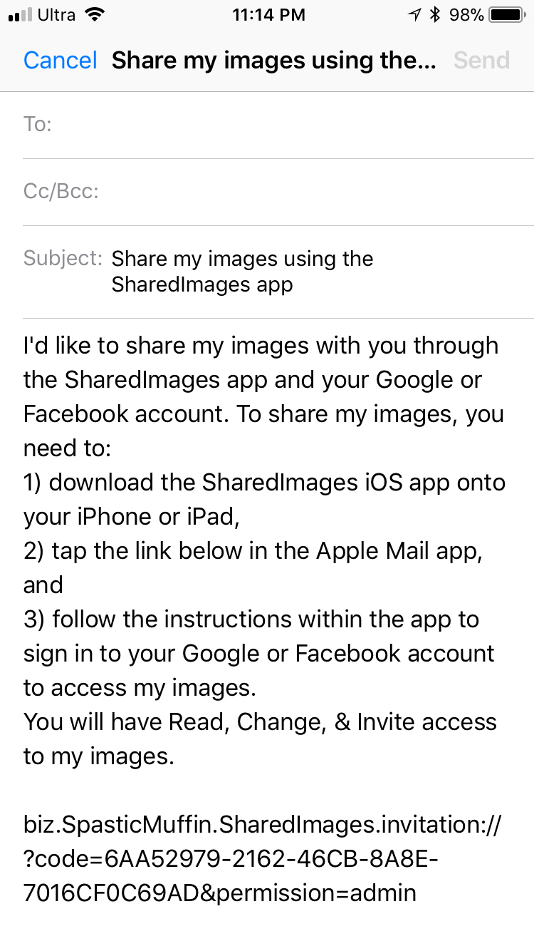
2) Share with someone (e.g., Facebook user)
Notes:
Sharing user gets permissions to the sharers Google Drive data by virtue of redeeming this sharing invitation;
Server connects that new sharing account as having permissions to share the data.

Slide 14
3) Sharing user downloads
Notes:
Server uses the sharing users effective owning user to access Google Drive; credentials (OAuth2 token) for that user are stored in the server database.

Slide 15
Next steps: Moving out of “beta”
Multiple-version files (in progress)
Support for groups
Developer & API documentation
Deal with Google sign-in library issue
Downloads need “collection” support
Notes:
Docs I have right now are mostly for installation not for concepts and API.
Google iOS/client library issue: Google sign-in uses a static library right now, and can not be directly incorporated into the iOS client library cocoapod like I’m doing with Dropbox, and Facebook.
“collection” support: I.e., make it so a client app can identify collections of files that need to be uploads and downloads can be grouped together and uploaded and downloaded as a unit. We’ve more or less got this with uploads. But don’t for downloads. See https://github.com/crspybits/SyncServer-iOSClient/issues/29

Slide 16
Further reading
https://github.com/crspybits/SyncServerII
https://github.com/crspybits/SyncServer-iOSClient
https://github.com/crspybits/SharedImages
https://crspybits.github.io/SyncServerII/

Slide 17
Some technical characteristics
Authentication: Three phases:
1) app: authorization with sign-in provider (e.g., Google)
2) server: check access token with sign-in provider
3) check that this user is on server
Optimistic synchronization
“master version” summarizes state of one user’s data; gets updated on any committed upload batch
Downloads & uploads send a master version; if doens’t match, operation fails
Locks are only held (a) on the server, and (b) only briefly
Uploads and downloads take place concurrently– different users
Batches of upload deletions & file uploads
Done in atomic manner: The group is committed or fails to commit
Downloads-- carried out in an eventually consistent manner
Both server and (iOS) client are written in Swift
Database: mySQL

