Slide 1
Server-side Swift and SyncServerII
Christopher G. Prince
Principal iOS Developer, roster
MIT open-source license
https://github.com/crspybits/SyncServerII
Notes:
I want to make this talk interactive. And I’m happy to reshape it depending on interest. Feel free to ask questions!!
Open source system to mobile apps to (a) store user data in users cloud storage (e.g., Google Drive), and (b) safely share that cloud data with other users (e.g., Facebook)

Slide 2
Thanks to
Bushrod Thomas, Daniel Ligas, & Natasha Vizcarra
for beta testing and feedback
Jim Dotter & Simrod Furman
for Docker, Swift and related discussions
To Rob Carpenter
for devops advice

Slide 3
Goals of this presentation
Swift basics
Custom-server
Running your code on Linux
Hosting
Frameworks
Swift package manager
Xcode
SyncServerII
Server
Client interface
iOS apps
Notes:
https://www.intego.com/mac-security-blog

Slide 4
Swift Basics
Example open source usage: HTTP server built using Swift
Run on MacOS or Linux
For Linux, Apple distributes builds for Ubuntu
Why Swift on a server?
Use your Swift skills on a server
Modern language
Sharing code? E.g., I have https://github.com/crspybits/SyncServer-Shared
Frameworks & libraries
Perfect, Vapor, Kitura: HTTP and other server services
No streaming HTTP with Kitura
Foundation: About 80%
Limited open source libraries (Don’t expect Node.js!)
Notes:
SyncServer: My project using server-side Swift and iOS/Swift client-side
https://medium.com/@rymcol/benchmarks-for-the-top-server-side-swift-frameworks-vs-node-js-24460cfe0beb
How much work is it to install Swift on Redhat or other distros?
Swift server performance: https://medium.com/@rymcol
https://github.com/apple/swift-corelibs-foundation/blob/master/Docs/Status.md
E.g., there was no Swift Google API-– had to brew my own in Swift
No NSBundle!
Dealing with having to redundanty give test method names: https://oleb.net/blog/2017/03/keeping-xctest-in-sync/
Things tend to break, e.g.:
Gloss (JSON library) isn’t yet supporting Linux
Zewo Reflection broke with Xcode 8.3
Relevancy of streaming: I eventually want to pass a stream to cloud storage and not have to first upload to the web server, then then to cloud storage.
Make sure you explicitly import Foundation
Not always necessary in Xcode, but it is on Ubuntu to get access to NSObject, TimeInterval, Date, ...
What will you miss?? What will not be there?
“I would still default to using Foundation types, even though the Xcode has no good way of telling you if it will work on Linux.” (https://realm.io/news/slug-jeff-bergier-building-production-server-swift-app/)
https://github.com/apple/swift-corelibs-foundation
https://github.com/apple/swift-corelibs-foundation/blob/master/Docs/Status.md
Apple open-sourced Swift (Dec/2015)
Swift is used on on Apple’s main hardware platforms
iOS, watchOS, tvOS; Apple promising stability soon.

Slide 5
Getting your code running on Linux
Some conditional compilation
Need for #if os(Linux) and #if os(macOS)
My server only had about ½ dozen
Some loveliness with NSNumbers
At least with Swift 3, there was no automatic bridging between NSNumbers and more standard Swift numeric types
No Objective-C code or runtime!
XCTests
You have to redundantly specify the list of tests to run on Linux
But see: https://oleb.net/blog/2017/03/keeping-xctest-in-sync/
Notes:
Apparenty now 80% of Foundation is on Linux (according to IBM talk at Swift Summit, 11/1/17
One of the places where I have conditional compilation in the server:
#if os(Linux)
let rand = random() % Int(len)
#else
let rand = arc4random_uniform(len)
#endif

Slide 6
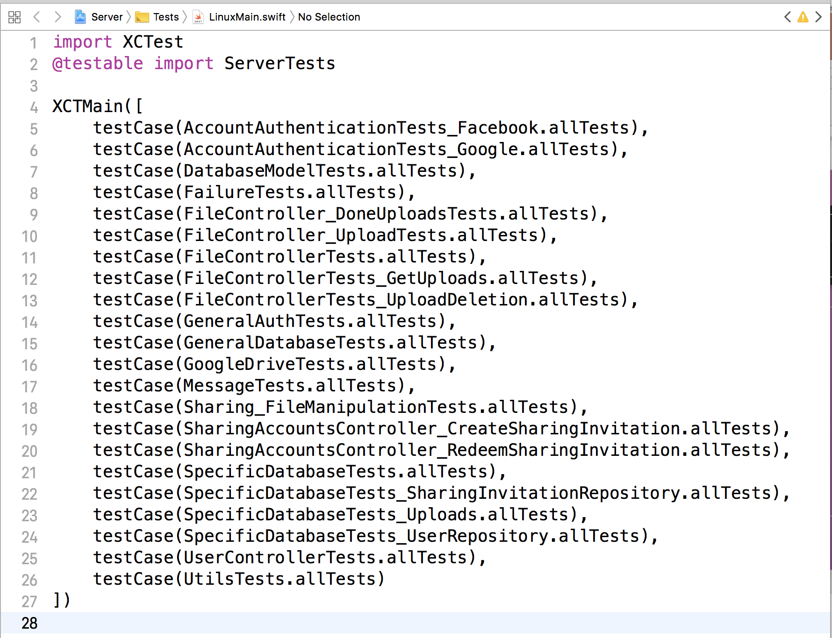
Notes:
`testCase` is something built-in

Slide 7
Hosting
I am using AWS, and Ubuntu Linux and have gone through a few phases
Phase 1: ec2 instance, and SSL through Kitura
Phase 2: ec2 instance, and NGINX proxying requests to server
Server has been up since Oct 1, 2017 without a restart and no signs of degradation
Phase 3: Elastic Beanstalk
Getting ready for a production deploy
Using a single Docker container, AWS SSL Certificate Manager, single EC2 instance, but load balancer for the SSL certificate
Most of the Elastic Beanstalk configuration is done in the “application bundle”
https://crspybits.github.io/SyncServerII/
Notes:
Swift runs on Mac OS, and Ubuntu Linux as distributed by swift.org, but presumably you can build for other distros
My link gives procedure for setting up server on AWS
I stopped using SSL with Kitura because of problems:
Downloads of files would fail on a regular basis– with server threads becoming blocked
Server would become unresponsive
I can’t say for sure this was due to SSL on Kitura, but the problems went away after I switched to using NGINX
Confguration of the application bundle include:
Creates the Server.json file in the Docker container to configure the server
Creates an NGINX configuration file
env.yml manifest for Elastic Beanstalk configuration
Dockerrun.aws.json file which points to the Docker container on hub.docker.com and sets up a few other things for Docker.
Getting ready for a production deploy. I have some needs that I think need something beyond manually deployed ec2 instances:
Rolling out new code versions without server downtime.
Updating server in other ways without downtime.
Possible autoscaling
Running a staging or development server

Slide 8
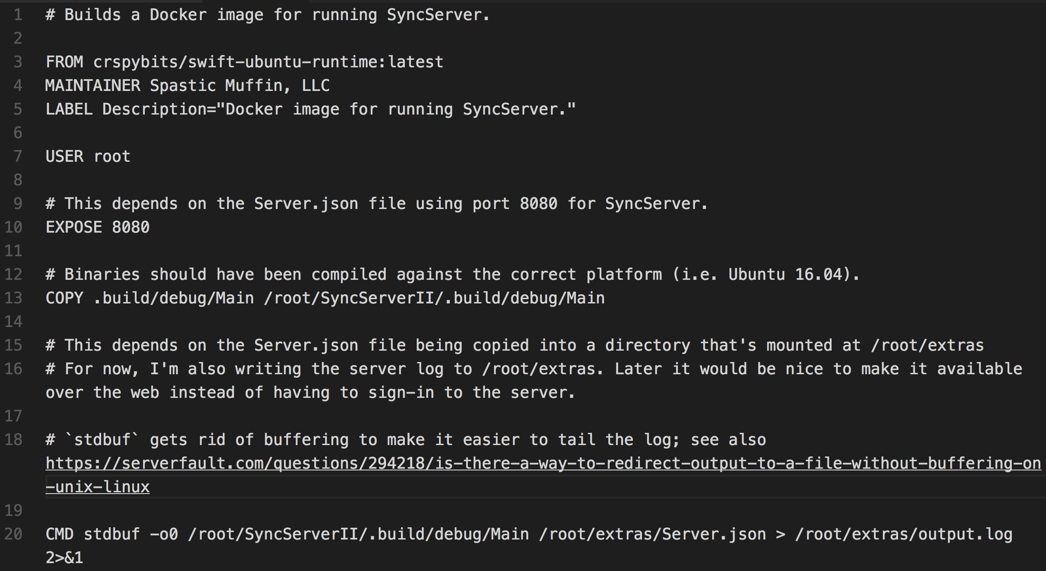
https://github.com/crspybits/SyncServerII/blob/master/Dockerfile

Slide 9
Swift package manager
Not yet for “regular” Apple platforms (e.g., iOS)
swift package init
Executable or library packages
Notes:
Could be good to step them through creating a new package, including adding the package to a repo.
“It also does not support iOS, watchOS, nor tvOS at this time.” (https://ustwo.com/blog/exploring-server-side-swift)
See also https://www.raywenderlich.com/148832/introduction-swift-package-manager

Slide 10
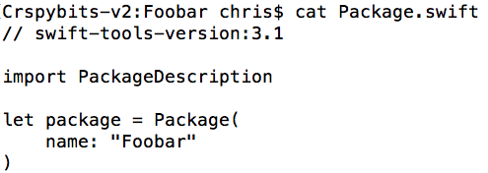
Add in dependencies
Notes:
Package.swift is analogous to package.json

Slide 11
Xcode?
You can generate an Xcode project from a Swift package
swift package generate-xcodeproj
Uses of Xcode for server development
As an editor
Run your server
Run unit and integration tests
Set breakpoints
Gotcha
Watch out making changes in your Xcode project
The next time you regenerate the xcode project, you will lose those changes!
I ended up having to make a Ruby script that does some tweaks to my Xcodeproj after it’s created
Notes:
Xcode is an IDE that is typically used for iOS, Watch OS and TV OS development. But, to some degree you can also use it for server development.
Example of an Xcode setting: A SERVER or DEBUG flag in the build.

Slide 12
SyncServer: Overview
Project concept: Enable mobile apps to (a) store user data in user owned cloud storage (e.g., Google Drive), and (b) safely share that cloud data with other users (e.g., Facebook)
Birth: Node.js and Mongo
But, Mongo didn’t seem well suited to transactions/rollbacks
And I ran into a design issue: Locks were held by client
Plus, when I bought a house, I lost steam on the project!
Rebirth: Swift and mySQL
Optimistic locking mechanism
Using Kitura and Perfect frameworks
Notes:
What I mean by safe: So that other users don’t generally have access to your cloud storage. Just the files you want them to have access to.
How much work is it to install on Redhat or other distros?
General orientation of SyncServer is file-based data storage.
Server: Swift for all components.

Slide 13
Architecture
Facebook
Other sign-ins
(planned)
Mobile iOS app
Server
Google Drive
Client interface
Your app code here
Sign-ins
Google
Dropbox
(planned)
Facebook
mySQL
Dropbox
...
...
Notes:
A single app type requires its own server
mySQL only stores meta-info and not content
Requests to cloud storage go through the server for security purposes– so that a sharing user doesn’t have cloud storage creds going back to the mobile app.
I wonder if we could integrate a P2P network. E.g.,
https://www.resilio.com/blog/sync-hacks-a-complete-guide-to-creating-your-own-private-dropbox
https://www.resilio.com/individuals/
https://lifehacker.com/should-i-use-bittorrent-sync-instead-of-dropbox-1522881147
Perhaps BitTorrent Sync could just be used as a Dropbox or cloud storage replacement:
https://computers.tutsplus.com/tutorials/build-your-own-self-hosted-dropbox-with-bittorrent-sync--cms-21836
https://www.resilio.com/blog/how-to-create-a-secure-cloud-with-bittorrent-sync-amazon-ec2

Slide 14
Current State of SyncServer System
Generally: Beta
Credentials/cloud storage
Google: Sign-in + cloud storage
Facebook: Sign-in
Code open-source on github
20,100 lines of code in four repos (95% Swift); 325 automated test cases
Server
Single versioned files in cloud storage
Client interface for iOS
Online and offline client usage ... mostly
iOS mobile app
SharedImages app in Apple TestFlight beta
Notes:
By beta, I mean: Not yet deployed in production
Single versioned files: Not yet dealing with versioning conflicts: i.e., one two devices making concurrent changes to the same file
No streaming yet; bottleneck/server limitation (Kitura limitation)
Stats:
Nearly all code in Swift
20617 lines of code
280 automated test cases
Test cases:
118 in client
207 in server
Totals:
8309
2477
7436
2395
--------
20617
Subtracting Markdown totals:
20142
Swift totals:
7876
1955
7338
1903
Server: -------------------------------------------------------------------------------
Language files blank comment code
-------------------------------------------------------------------------------
Swift 61 2155 959 7876
Bourne Shell 3 41 48 116
Dockerfile 3 20 42 94
JSON 4 18 0 89
YAML 3 1 0 63
Markdown 2 27 0 41
Ruby 1 14 15 26
SQL 1 0 0 4
-------------------------------------------------------------------------------
SUM: 78 2276 1064 8309
-------------------------------------------------------------------------------
Shared library: -------------------------------------------------------------------------------
Language files blank comment code
-------------------------------------------------------------------------------
Swift 31 898 1081 1955
Markdown 2 198 0 396
Bourne Shell 1 8 1 90
C/C++ Header 2 6 0 26
Objective C 2 0 0 10
-------------------------------------------------------------------------------
SUM: 38 1110 1082 2477
-------------------------------------------------------------------------------
iOS Client
-------------------------------------------------------------------------------
Language files blank comment code
-------------------------------------------------------------------------------
Swift 72 2340 1106 7338
JSON 3 0 0 77
Markdown 2 14 0 21
-------------------------------------------------------------------------------
SUM: 77 2354 1106 7436
-------------------------------------------------------------------------------
Shared Images:
-------------------------------------------------------------------------------
Language files blank comment code
-------------------------------------------------------------------------------
Swift 24 538 318 1903
JSON 15 0 0 350
Objective C 1 33 8 119
Markdown 2 10 0 17
C/C++ Header 2 8 14 6
-------------------------------------------------------------------------------
SUM: 44 589 340 2395
-------------------------------------------------------------------------------

Slide 15
Server endpoints
Endpoint | Description
HealthCheck | Check on server health
CheckCreds | Client sign-in; sends Facebook or Google Oauth access token
AddUser | Creates an owning user; currently can only be Google
RemoveUser | Remove calling user.
FileIndex | Get metadata on shared files & current master version for effective owning user
UploadFile | Stage a file for uploading to effective owning users cloud storage
Endpoint | Description
UploadDeletion | Stage a request to delete a file from cloud storage
DoneUploads | Commit file uploads and upload deletions– but only if master version unchanged.
DownloadFile | Download a single file from effective owning users cloud storage
CreateSharingInvitation | Invite a user to share effective owning user’s data
RedeemSharingInvitation | Creates a sharing user; Facebook or Google
Notes:
There are currently three levels of priviledges:
Read
Read & write
Read & write & admin
Only admin allows inviting others.
Client passes last known master version to server when doing UploadFile, UploadDeletion, DoneUploads, or DownloadFile; Server fails operation if master version out of date

Slide 16
Server database tables
Table | Column
DeviceUUID (*) | userId, deviceUUID
Lock | userId, deviceUUID, expiry
MasterVersion (*) | userId, masterVersion (Int)
SharingInvitation | sharingInvitationUUID, expiry, owningUserId, sharingPermission
User (*) | userId, username, userType, owningUserId, sharingPermission, accountType, credsId, creds
FileIndex (**) | fileIndexId, fileUUID, userId, deviceUUID, creationDate, updateDate, mimeType, cloudFolderName, appMetaData, deleted, fileVersion
Upload | uploadId, fileUUID, userId, deviceUUID, creationDate, updateDate, mimeType, cloudFolderName, appMetaData, fileVersion, state
Current DB Sizes
200K indexes
200K tables
-------
400K total
For 90 cloud data files totalling 55MB in size
And 6 users
Owning user creds
Notes:
credsId: Specific to the account type, e.g., Google.
creds: Stored as JSON– specific to the account type
See https://github.com/crspybits/SyncServerII/issues/36 for methods used to compute sizes
(*) Number of rows same as number devices used by users or number of users on system
(**) Number of rows is the number of files on system (including those deleted in the past)
The other tables have a purely temporary functionality: The rows are deleted regularly.
For a Google owning user, the owning user creds are: a refreshToken obtained via aserverAuthCode sent up from the client.
This gives (unless a user explicitly revokes it) effectively permanent access to the cloud storage.

Slide 17
iOS Client Interface: Sign-In
public class SignInManager : NSObject
public func addSignIn(_ signIn: GenericSignIn, launchOptions options: [UIApplicationLaunchOptionsKey: Any]?)
public func getSignIns(`for` signInType: SignInType) -> [GenericSignIn]
public var currentSignIn: GenericSignIn?
public class GoogleSyncServerSignIn : NSObject, GenericSignIn
public class FacebookSyncServerSignIn : GenericSignIn
public protocol GenericSignIn : class
public protocol GenericCredentials
Notes:
The GenericSignIn’s have UI mechanisms to support sign-in.

Slide 18
iOS Client Interface: File related
public func appLaunchSetup(withServerURL serverURL: URL, cloudFolderName:String)
public func uploadImmutable(localFile:SMRelativeLocalURL, withAttributes attr: SyncAttributes) throws
public func delete(filesWithUUIDs uuids:[UUIDString]) throws
public func sync()
public func stopSync()
public func getStats(completion:@escaping (Stats?)->())
public func localConsistencyCheck(clientFiles:[UUIDString]) throws
public weak var delegate:SyncServerDelegate?
Notes:
public struct Stats {
public let downloadsAvailable:Int
public let downloadDeletionsAvailable:Int
}
This iOS Client is a Cocoapod
public struct SyncAttributes {
public var fileUUID:String!
public var mimeType:String!
public var creationDate:Date?
public var updateDate:Date?
public var appMetaData:String?
public init(fileUUID:String, mimeType:String, creationDate: Date? = nil, updateDate: Date? = nil) {
self.fileUUID = fileUUID
self.mimeType = mimeType
self.creationDate = creationDate
self.updateDate = updateDate
}
}

Slide 19
iOS Client Interface: Delegate
public protocol SyncServerDelegate : class {
func singleFileDownloadComplete(url:SMRelativeLocalURL, attr: SyncAttributes)
func shouldDoDeletions(downloadDeletions:[SyncAttributes])
func syncServerErrorOccurred(error:Error)
func syncServerEventOccurred(event:SyncEvent)
}
Notes:
public struct Stats {
public let downloadsAvailable:Int
public let downloadDeletionsAvailable:Int
}
public enum SyncEvent {
// This can repeat if there is a change to the files on the server (a master version update), and downloads restart.
case willStartDownloads(numberDownloads:UInt)
case singleFileUploadComplete(attr:SyncAttributes)
case singleUploadDeletionComplete(fileUUID:UUIDString)
case fileUploadsCompleted(numberOfFiles:Int)
case uploadDeletionsCompleted(numberOfFiles:Int)
case syncStarted
// Occurs after call to stopSync, when the synchronization is just about to stop. syncDone will be the next event (if desired).
case syncStopping
case syncDone
case refreshingCredentials
}

Slide 20
Synchronization Algorithm
1a
1b
2a
2b
Server
Server
Server
Server
Downloads available?
(FileIndex, master version)
...
Download files if needed
...
Upload files if needed
Commit (DoneUploads)
Client
Client
Client
Client
Notes:
This is an interaction between the server and and the client library – all done when you do a call to the client library sync method.
At each endpoint call after the FileIndex, if the masterVersion sent by the client differs from the master version on the server, the server fails the call. This is a form of optimistic locking– the idea is that the client should only be getting data from the server that reflects the FileIndex version that the client already knows about.
General assumption: A small number of users synchronizing data (for any single set of cloud data files), i.e., a relatively small probability of master version change during the synchronization process.
DoneUploads not only commits the pending file uploads and upload deletions, but it also increments the master version
1) Check for downloads
1a) Do a fileindex, getting meta data and master version
1b) Client does a "diff": Figures out which files it doesn't have
1c) Any files not on client are downloaded
1d) Any files on client needing deletion are deleted
2) If any file uploads or upload deletions
2a) Upload them
2b) Commit uploads (DoneUploads)

Slide 21
Demo Time!
SharedImages app
Server running on AWS (non-Elastic Beanstalk; with NGINX)
Google Drive folder with files stored for app
Notes:
DEMO! Connect into AWS and show the log from the running server. Also show the SharedImages app, running on my phone, from Quicktime.
I also want to show

Slide 22
SyncServer Next Steps
Plans
Devops procedures for using Elastic Beanstalk & Docker
Add support for multiple file versions
Add support for groups (e.g., to share images with separate groups of people)
Add other cloud storage support (e.g., Dropbox and Onedrive)
Add other demo apps (e.g., WhatDidILike)
Hopes & dreams
Getting other devs & users on board!
Streaming support (when available in Kitura)
Android client interface
Android apps using that interface.
Notes:
Multiple file versions is a difficulty mostly because of merge conflicts.

Slide 23
Favorite Swift & Xcode Errors
Unhandled DiagnosticKind in switch.
Notes:
﻿Unhandled DiagnosticKind in switch. Occurreed with Swift 3.1.1 on Linux. It was a compiler crash.

Slide 24
Links
chris@cprince.com
SyncServer github open source code
https://github.com/crspybits/SyncServerII
https://github.com/crspybits/SyncServer-Shared
https://github.com/crspybits/SyncServer-iOSClient
https://github.com/crspybits/SharedImages
Docs
https://crspybits.github.io/SyncServerII/
Swift in Docker containers
https://developer.ibm.com/swift/2017/02/14/new-runtime-docker-image-for-swift-applications
https://github.com/swiftdocker/docker-swift
https://hub.docker.com/u/crspybits/
https://github.com/crspybits/SyncServerII/blob/master/Dockerfile

Slide 25
Optimistic locking
Locks held for brief periods, and then only server-initiated
Master Version
Integer value maintained by server
Reported to client with FileIndex
Each DoneUploads request increments master version for that owning user
Client passes last known master version to server when doing UploadFile, UploadDeletion, DoneUploads, or DownloadFile
Server fails operation if master version out of date
General assumption: A small number of users synchronizing data (for any single set of cloud data files)
Client detects master version change: recovery takes place
Notes:
TODO: Really need a diagram illustrating upload process, and then the download process.
ASSUMPTION: Only a small number of users are accessing the same data, and rarely will users ever be uploading at the same time
Server locks are partly done through fact of using InnoDB with mySQL with a REPEATABLE READ isolation level.
When the server fails the operation in these cases, it sends updated master version back to client– though client will likely want to do a FileIndex again to see what changed.

Slide 26
Securing Your Kitura Server: SSL and HTTPS
Kitura has a little different support for SSL on MacOS vs. Linux
Self-signing certificates
Useful for testing, and can be used with Kitura
http://www.kitura.io/en/resources/tutorials/ssl.html
With iOS client, needed to have URLSessionDelegate for `didReceive challenge`
iOS9: Some Application Transport Security annoyances
You probably want to use CA signed certificates for production
Also supported by Kitura
I used https://letsencrypt.org
Free SSL certificates; 90 day expiry
Run the `certbot` program *on* AWS
Notes:
https://developer.ibm.com/swift/2016/09/22/securing-kitura-part-1-enabling-ssltls-on-your-swift-server/
I had first installed certbot on my Mac and then realized it was assuming I needed to run it on my server.

Slide 27
Securing Your Kitura Server: SSL and HTTPS (2)
Issues that came up
Seems that AWS EC2 doesn’t support forward secrecy:
https://forums.aws.amazon.com/thread.jspa?threadID=152343
https://stackoverflow.com/questions/32500655/
Need some secret sauce in the NSAppTransportSecurity
Spent 10 days figuring out timeout issue with large-ish downloads
Apparently it was a timeout issue with URLSession’s– had to use background sessions
https://github.com/IBM-Swift/Kitura-net/issues/196
https://stackoverflow.com/questions/44224048
I am still concerned that server threads could be left blocked

Slide 28
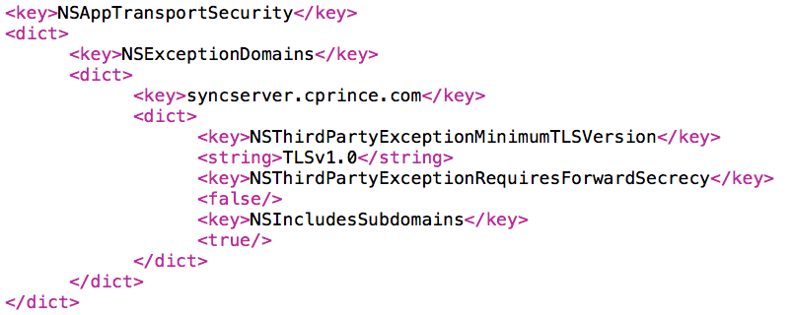

Slide 29
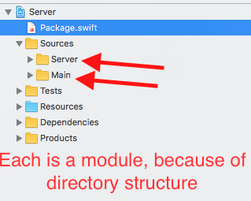
Notes:
Give command to generate Xcode project from your Swift project.

